Slide 1
Basic models
Cloud AI

Slide 2
AWS
Do module 2 now
Introduces general concepts
Repetition of what we did last week
Also do the knowledge check
And keep doing it until you reach 80%

Slide 3
Machine learning
Supervised learning
Unsupervised learning
Reinforcement learning
Classification
Regression
Clustering
Dimensionality reduction
Reinforcement learning
Notes:
We’ll be doing the orange parts

Slide 4
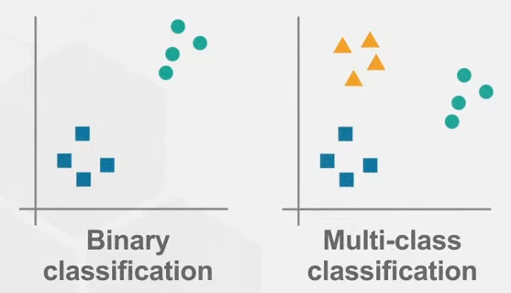
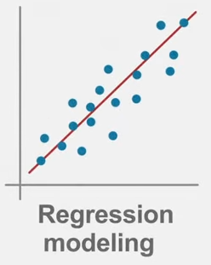
Supervised: Classification vs regression
Classification
Output is class label (discrete)
Looking for boundaries
Evaluate using accuracy
Binary: 2 labels, Multi-class: more than 2 labels
Regression
Output is number (continuous)
Looking for best fit line
Evaluate using sum of squared error (r²)
Notes:
https://www.youtube.com/watch?v=G_0W912qmGc
https://www.youtube.com/watch?v=rHeaoaiBM6Y

Slide 5
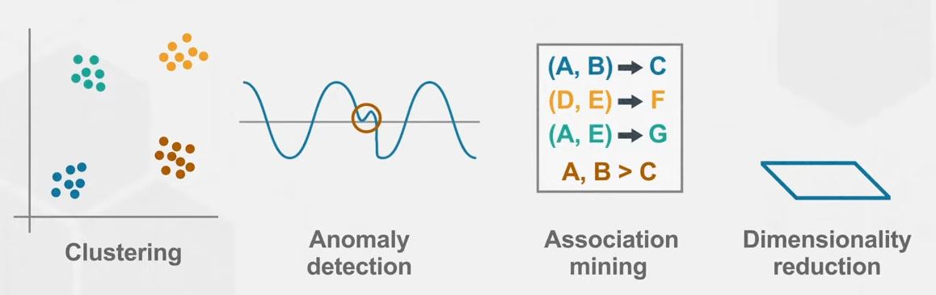
Unsupervised learning
Does not require a data scientist to prepare the data
Example: https://www.kaggle.com/code/ryati131457/titanic-unsupervised-kmeans
Some preparation
No guiding on which groups to make (you can’t ask the model who survived)
But you get 5 group of people that are at roughly the same location in some multidimensional space ^{(see next slide)}
Good to give insights in data beyond what regular statistics can do
Notes:
https://www.youtube.com/watch?v=rHeaoaiBM6Y
https://towardsdatascience.com/why-we-use-unsupervised-learning-with-k-means-clustering-from-scratch-1401efdd6fde

Slide 6
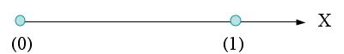
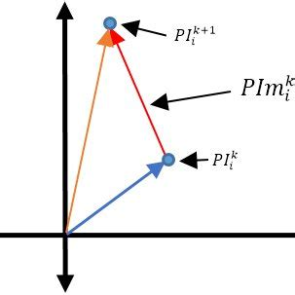

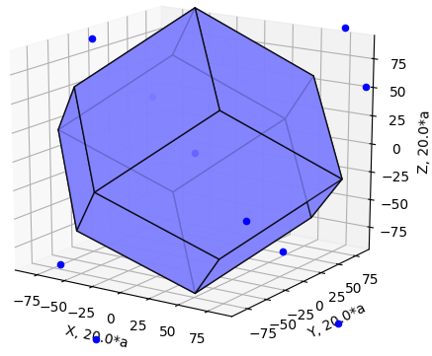


Multidimensional space
One dimensional:
Two dimensional:
Three dimensional:
More dimensional:
17 dimensions?
No problem.

Slide 7
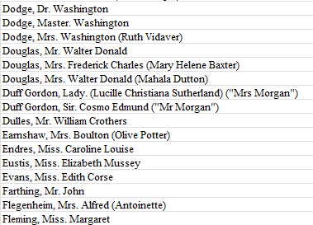
Feature engineering
Feature: measurable input that ca be used in a predictive model
Price per ticket to predict survival of Titanic
Feature engineering: convert raw observations into features
Name contains title (Mr., Mrs., Master., Lady., Sir., …)
Extracting this will yield a very valuable feature
Remember that we are doing supervised learning, so we are responsible for providing the model with the data and labels
Notes:
https://towardsdatascience.com/what-is-feature-engineering-importance-tools-and-techniques-for-machine-learning-2080b0269f10
https://www.kaggle.com/datasets/vinicius150987/titanic3

Slide 8
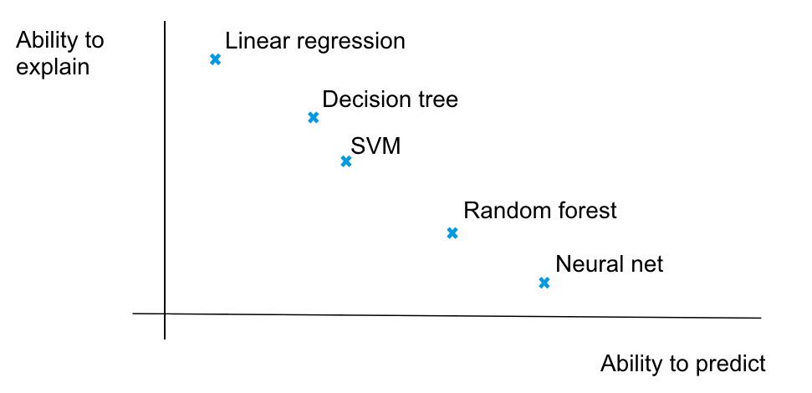
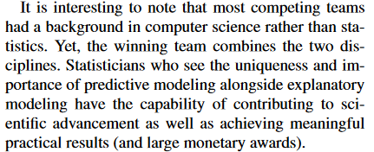
Creating models
We’ll be creating models that fit our data
In essence, any model can be used to predict and any model can be used to explain our data
But some models are better suited to the one or the other
Notes:
https://www.stat.berkeley.edu/~aldous/157/Papers/shmueli.pdf
https://medium.com/@nsorros/to-predict-or-to-explain-ddeb95ba9e25

Slide 9
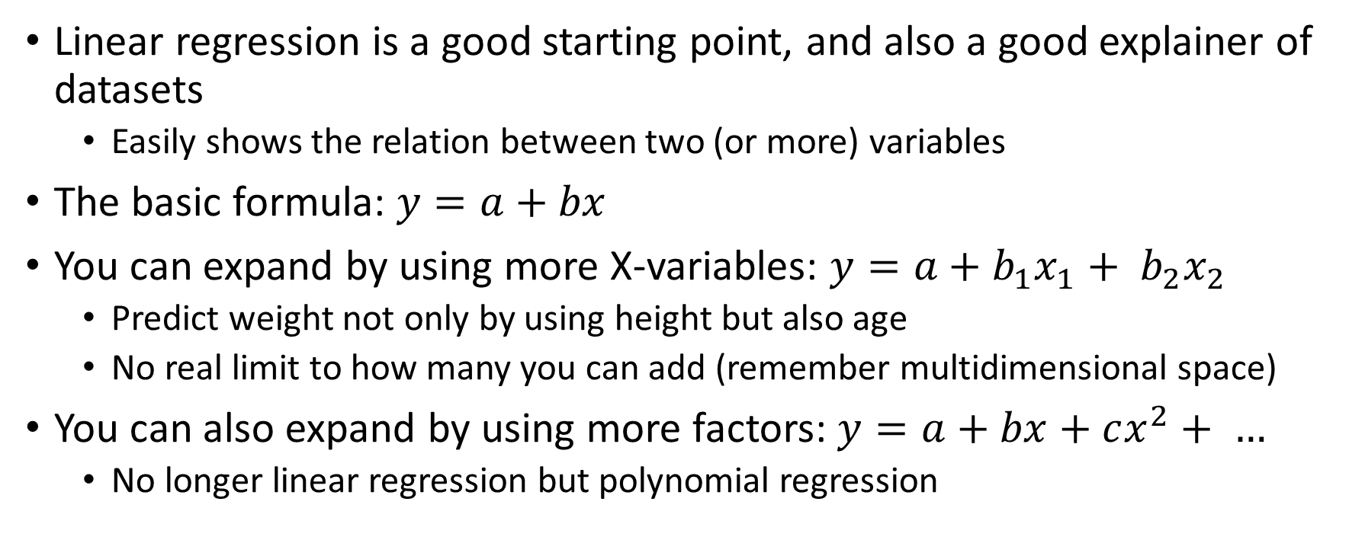
Linear regression
Linear regression is a good starting point, and also a good explainer of datasets
Easily shows the relation between two (or more) variables
The basic formula: $y=a+bx$
You can expand by using more X-variables: $y=a+b_{1}x_{1}+ b_{2}x_{2}$
Predict weight not only by using height but also age
No real limit to how many you can add (remember multidimensional space)
You can also expand by using more factors: $y=a+bx+cx^{2}+ …$
No longer linear regression but polynomial regression

Slide 10
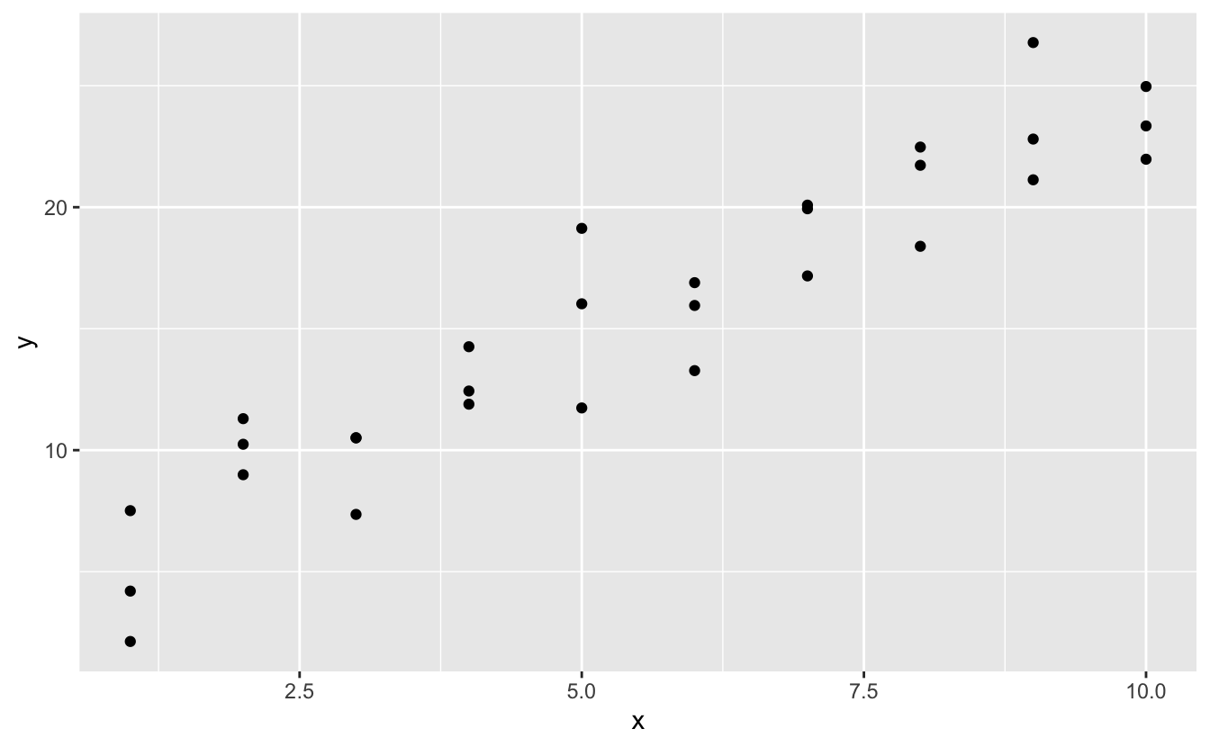
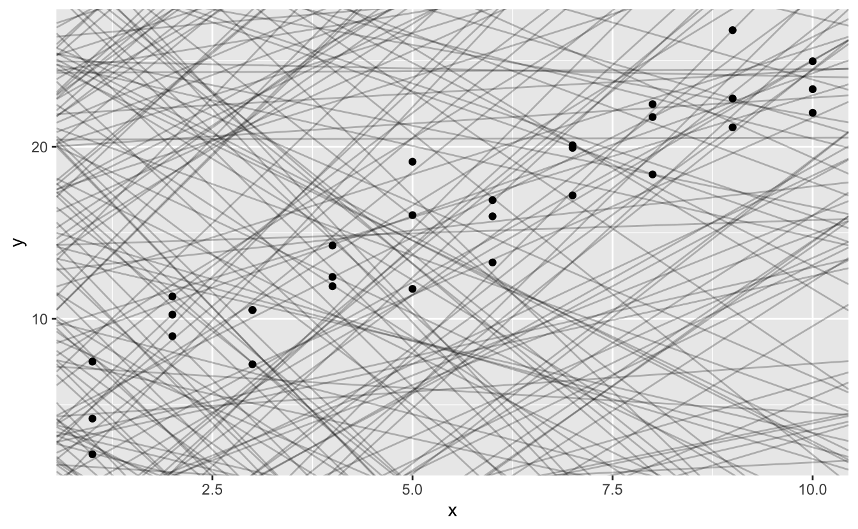
How does linear regression work?
Different (a, b) combinations

Slide 11
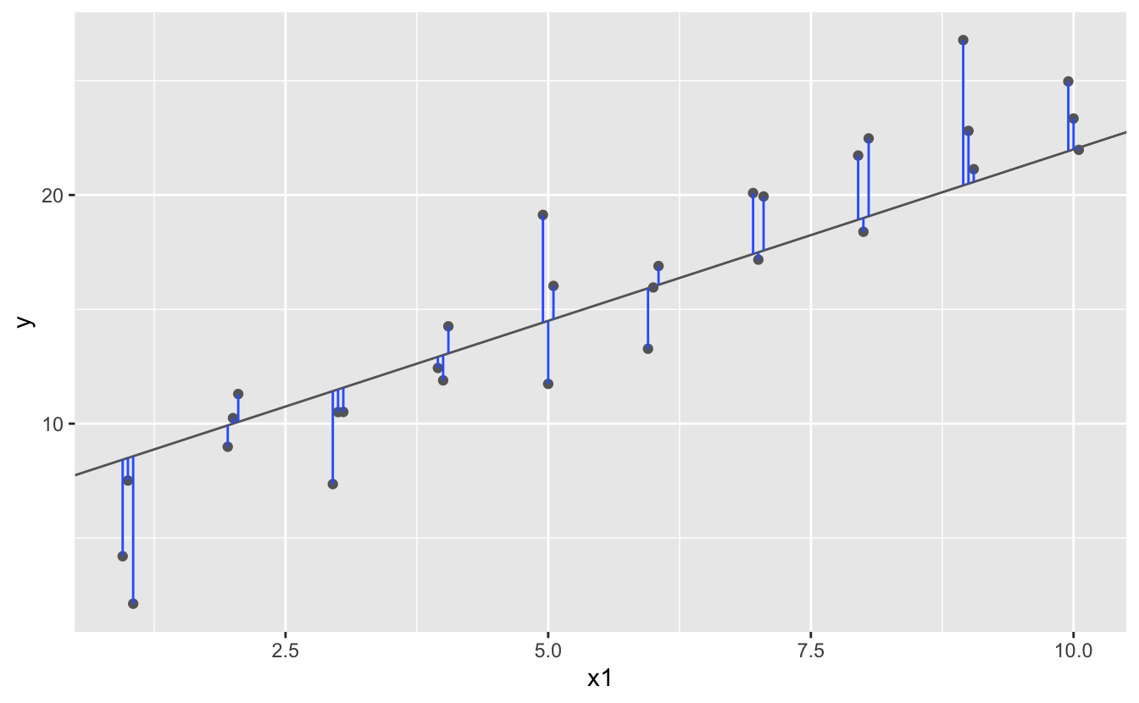
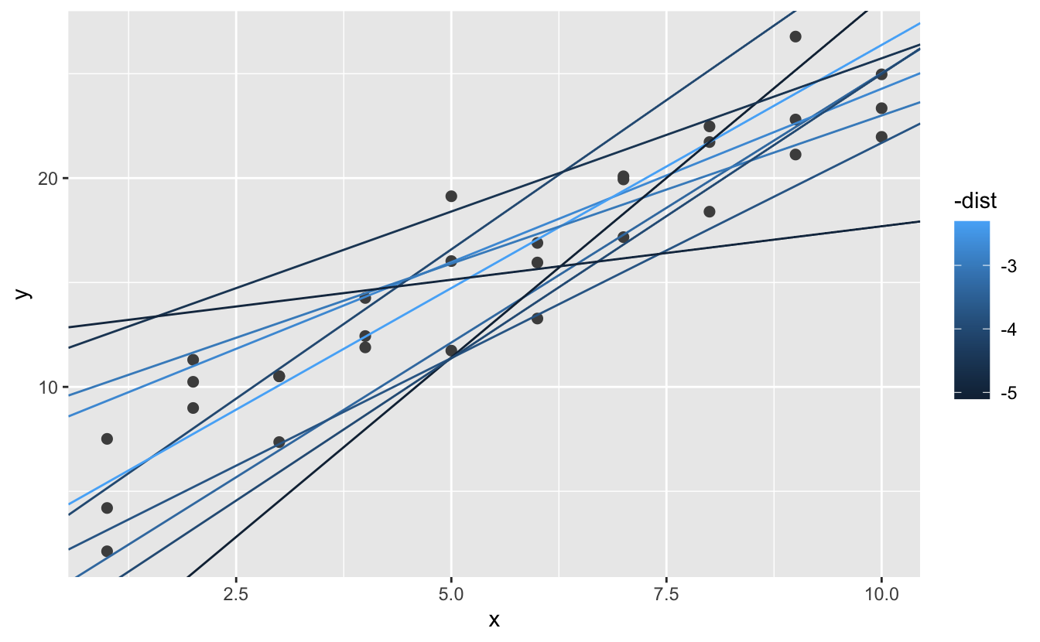
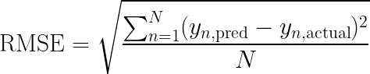
How does linear regression work?
Root-mean-square error

Slide 12
Root mean square?
Why do we use the RMSE to determine how good a model is?
There are other ways, but they have issues:
Simply add the errors: some errors are positive, others are negative. This doesn’t add up well.
Add the absolute value of the errors: Could work but we really want to penalize the big errors.
MSE: Same as RMSE, but not the root. Is a good metric, but isn’t in the same unit as the actual data (as it’s still squared). (See link in notes.)
RMSE: Squaring gets rid of the sign and increases the big errors. Value can be compared to the actual data.
Notes:
https://www.statology.org/mse-vs-rmse/
https://towardsdatascience.com/what-does-rmse-really-mean-806b65f2e48e

Slide 13
Calculating the residuals
The residuals are the differences between the calculated values and the predicted values, the errors
Remember that we were always working with two variables
If the residuals no longer show a pattern, that was the main defining correlation in the data
If the residuals still show some kind of a pattern the model doesn’t fully define the data (and won’t be able to predict it)

Slide 14
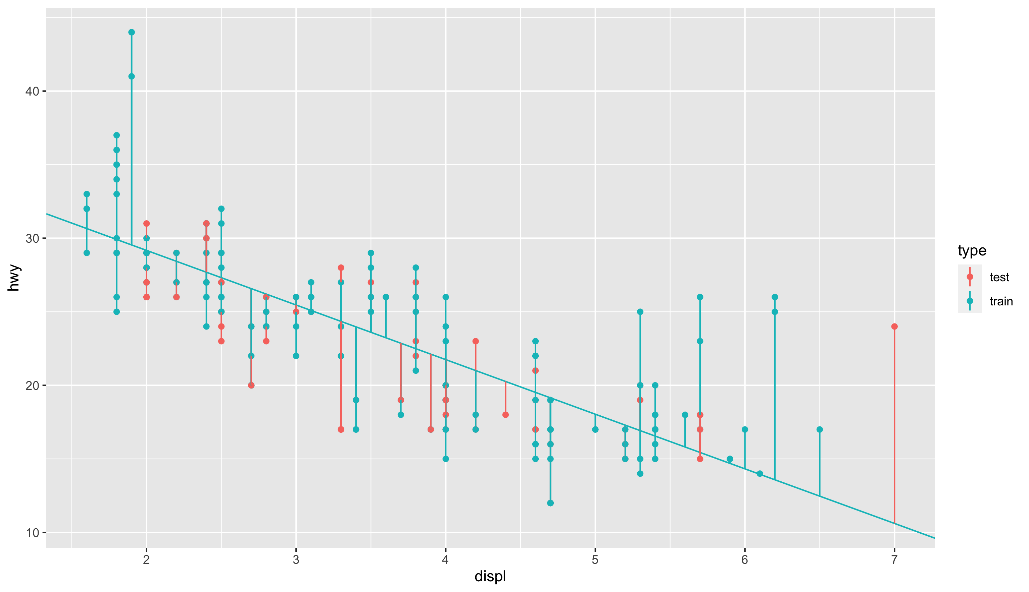
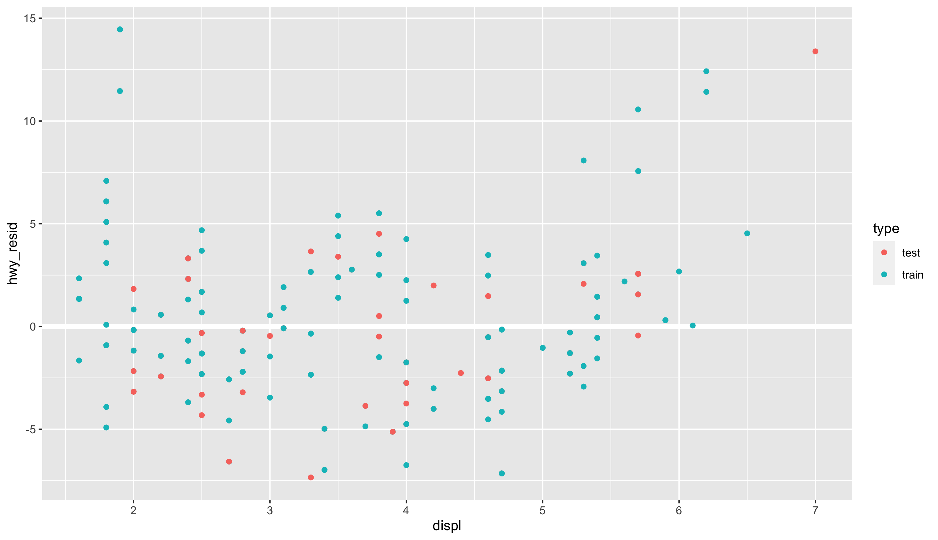
Calculating the residuals
hwy_{resid} = hwy_{actual} – hwy_{predicted}

Slide 15

When studying you should look at the jupyter notebook on linear regression now. It’s in the “scripts”-folder, and called “2.1 - linear regression.ipynb”

Slide 16
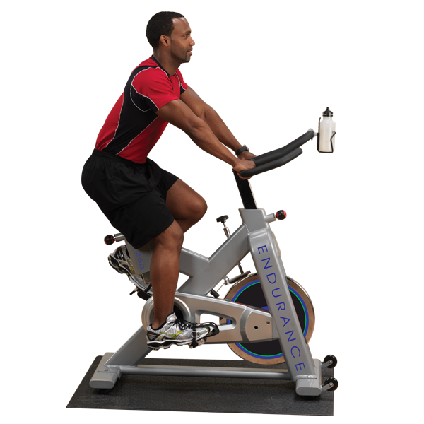
You are now ready for the Diamonds-exercises now. It’s in the “exercises”-folder, and called “2.1 - diamonds modeling.ipynb”

Slide 17
How good is the model?
The model should generalize to unseen data
If you are using it to predict, if it’s just to explain the data overfitting isn’t a problem
So split up the given dataset:
Build model on training dataset (e.g. 70%)
Test model using test set (remaining 30%)
Calculate RMSE on both datasets
Check that the RMSE on training is as low as it can be, but that the RMSE of test isn’t significantly higher

Slide 18
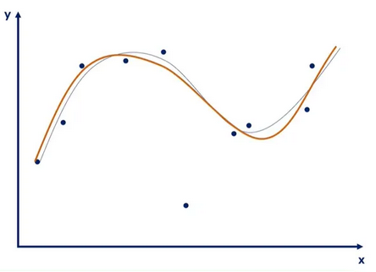
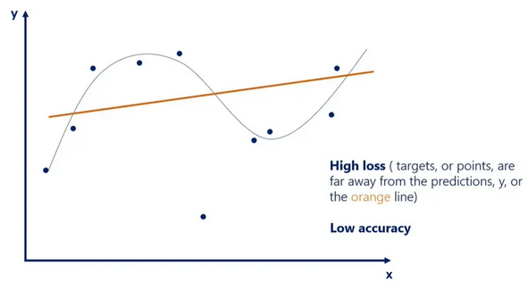
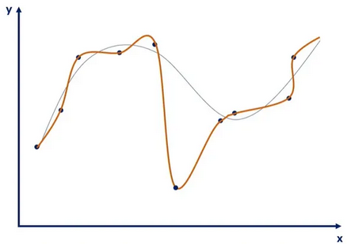
Overfitting and underfitting
Good model
Line follows datapoints correctly
Obvious outliers are ignored
Underfitting
Line only vaguely follows datapoints
Outliers are ignored, but some data points too
Is equally bad with unseen data as with trained data
Can be a bad model, but also not enough training
Overfitting
Line follows datapoints exactly
Outliers are taken very much into account
Does not generalize to unseen data
Model too complex, or too much training
Notes:
https://365datascience.com/tutorials/machine-learning-tutorials/overfitting-underfitting/
A lot more about this topic will follow in session 3.

Slide 19
Overfitting and underfitting
Overfitting and underfitting are measured using the RMSE
In the example in the previous slide we’re not using a linear regression but a polynomial regression
The question we are asking is how many polynomials we should be using
A 17th-order function will have 17 zero-crosses, so will follow the data very well, but have next to no explainability

Slide 20
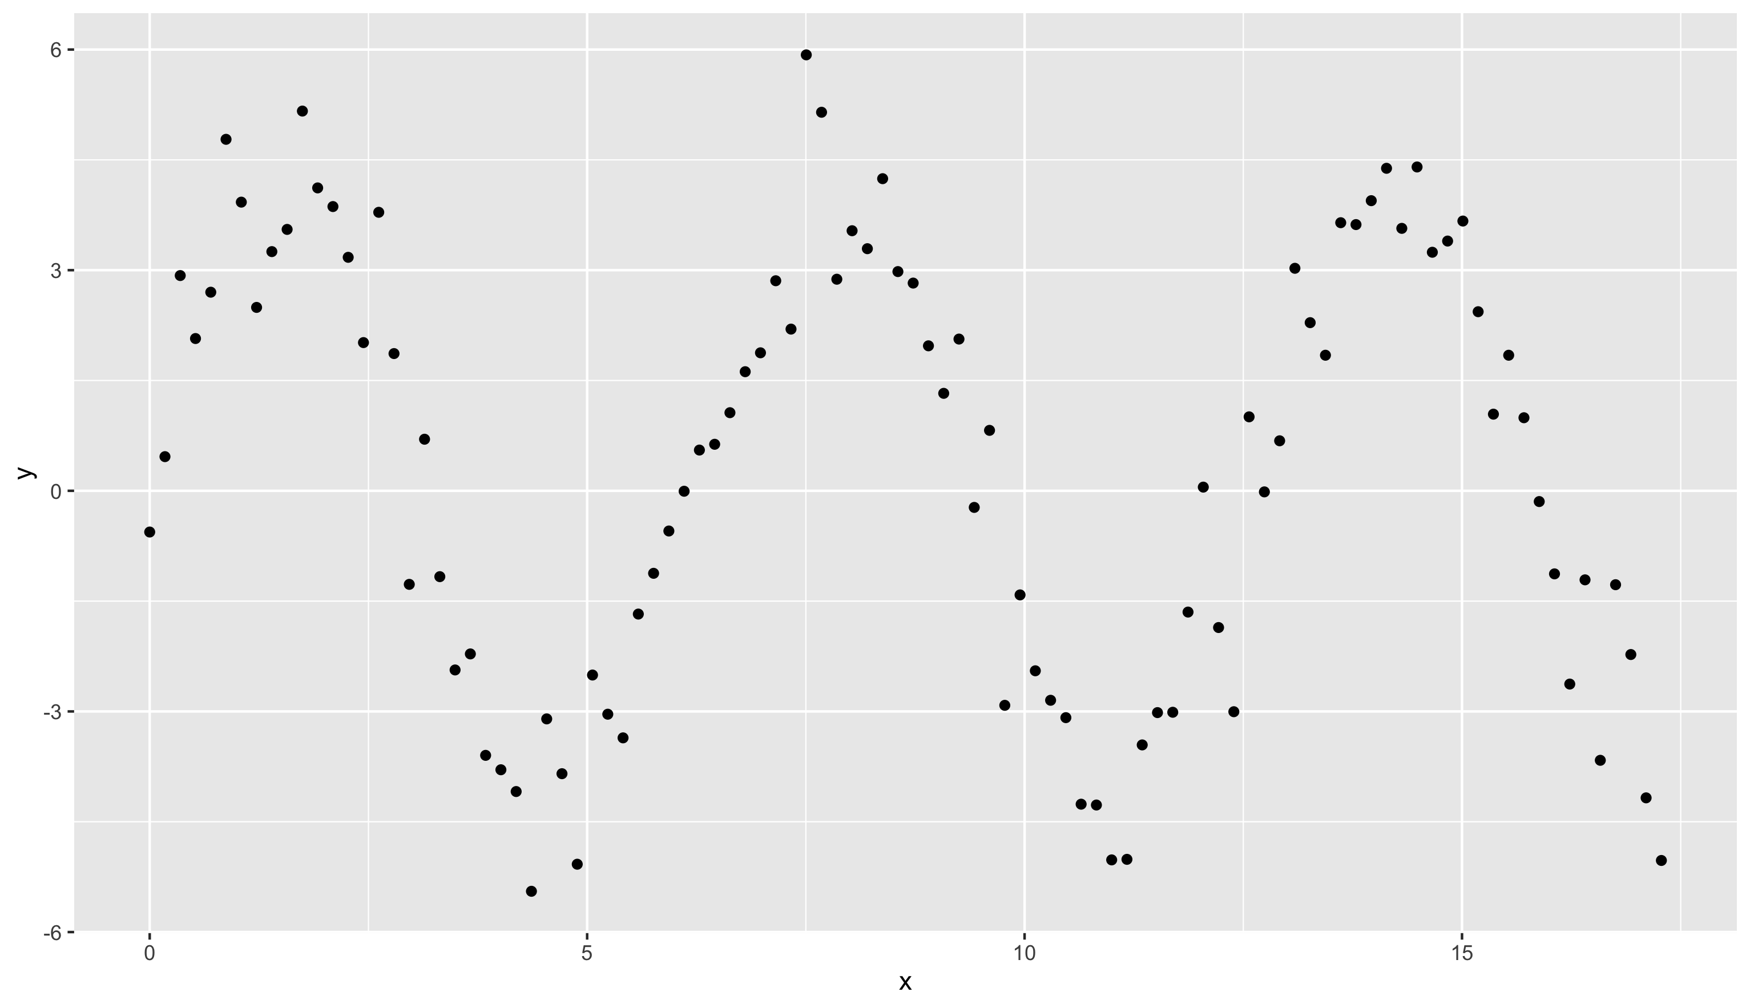
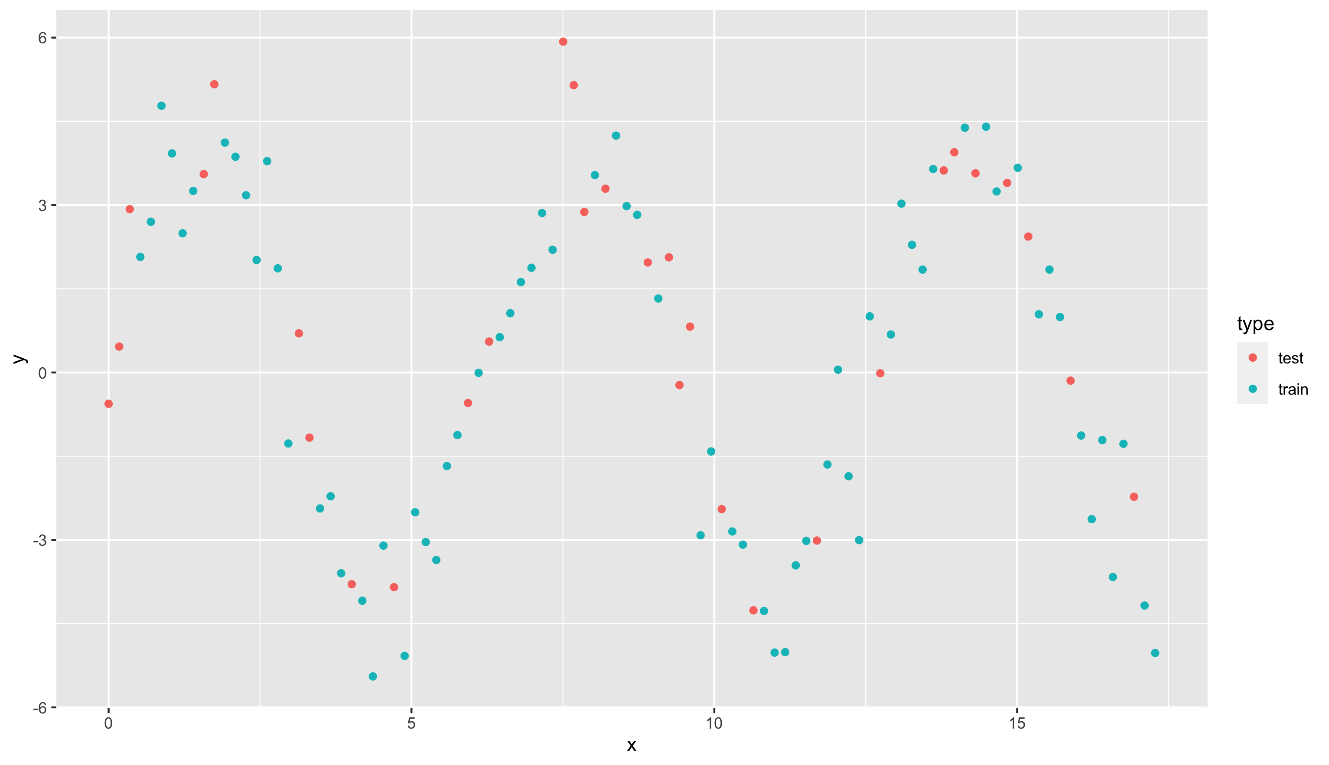
Modeling more complex patterns
A classical linear model will not do!

Slide 21
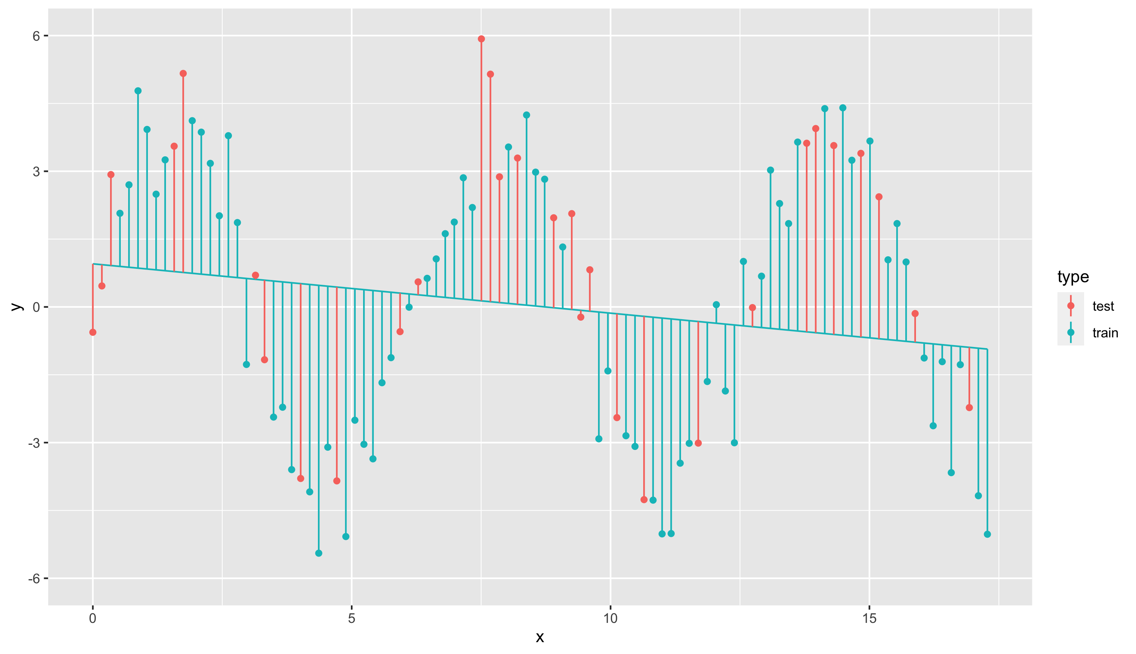
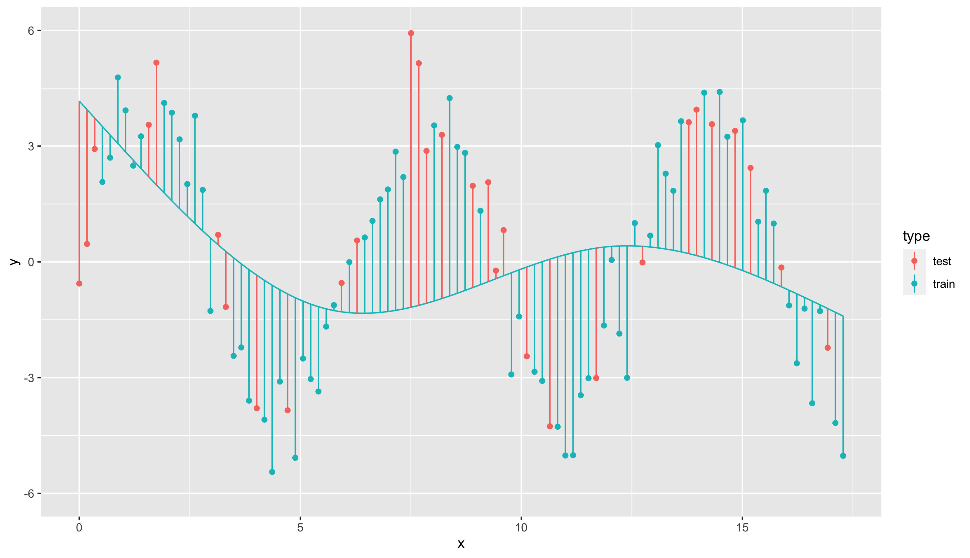
Modeling more complex patterns
Natural spline with 1 degrees of freedom
Natural spline with 3 degrees of freedom
RMSE_train = 2.971
RMSE_test = 3.020
RMSE_train = 2.779
RMSE_test = 3.204

Slide 22
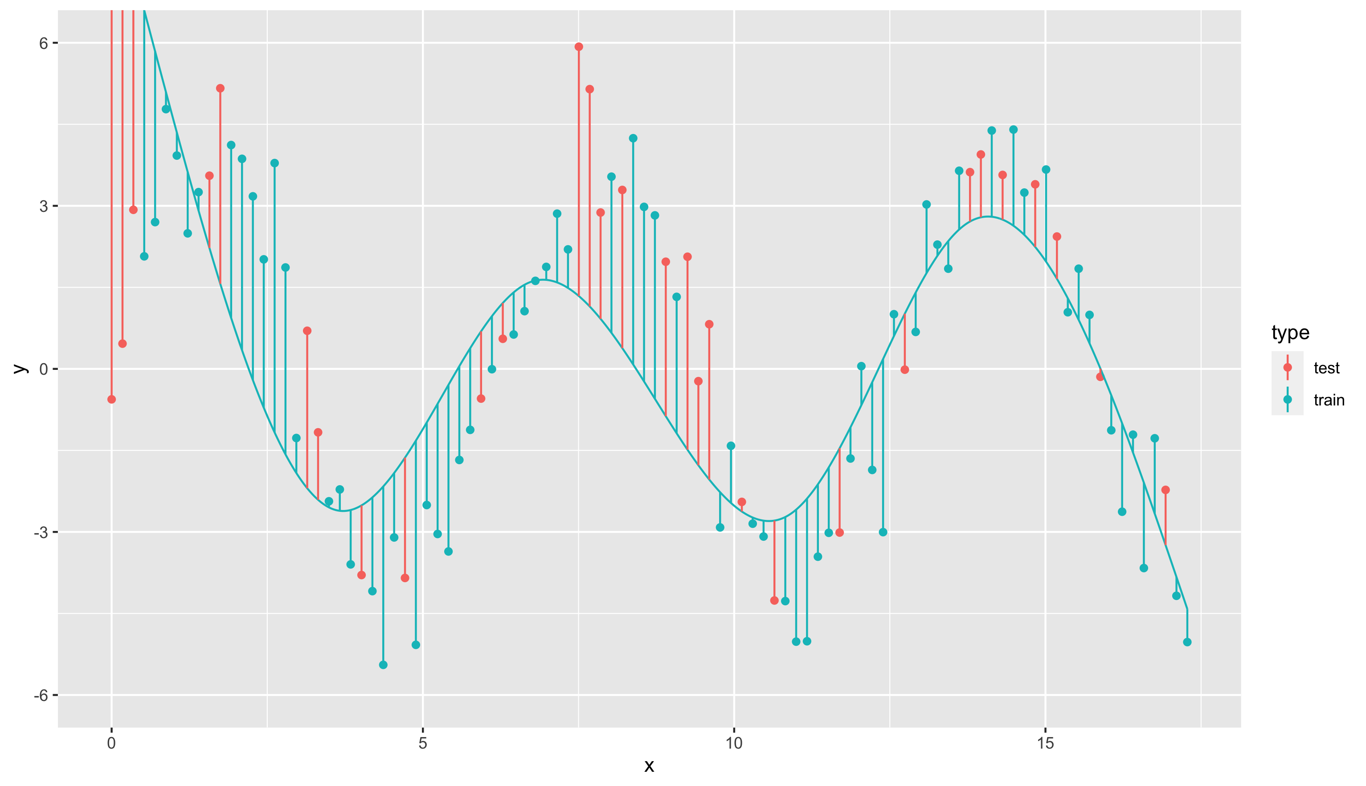
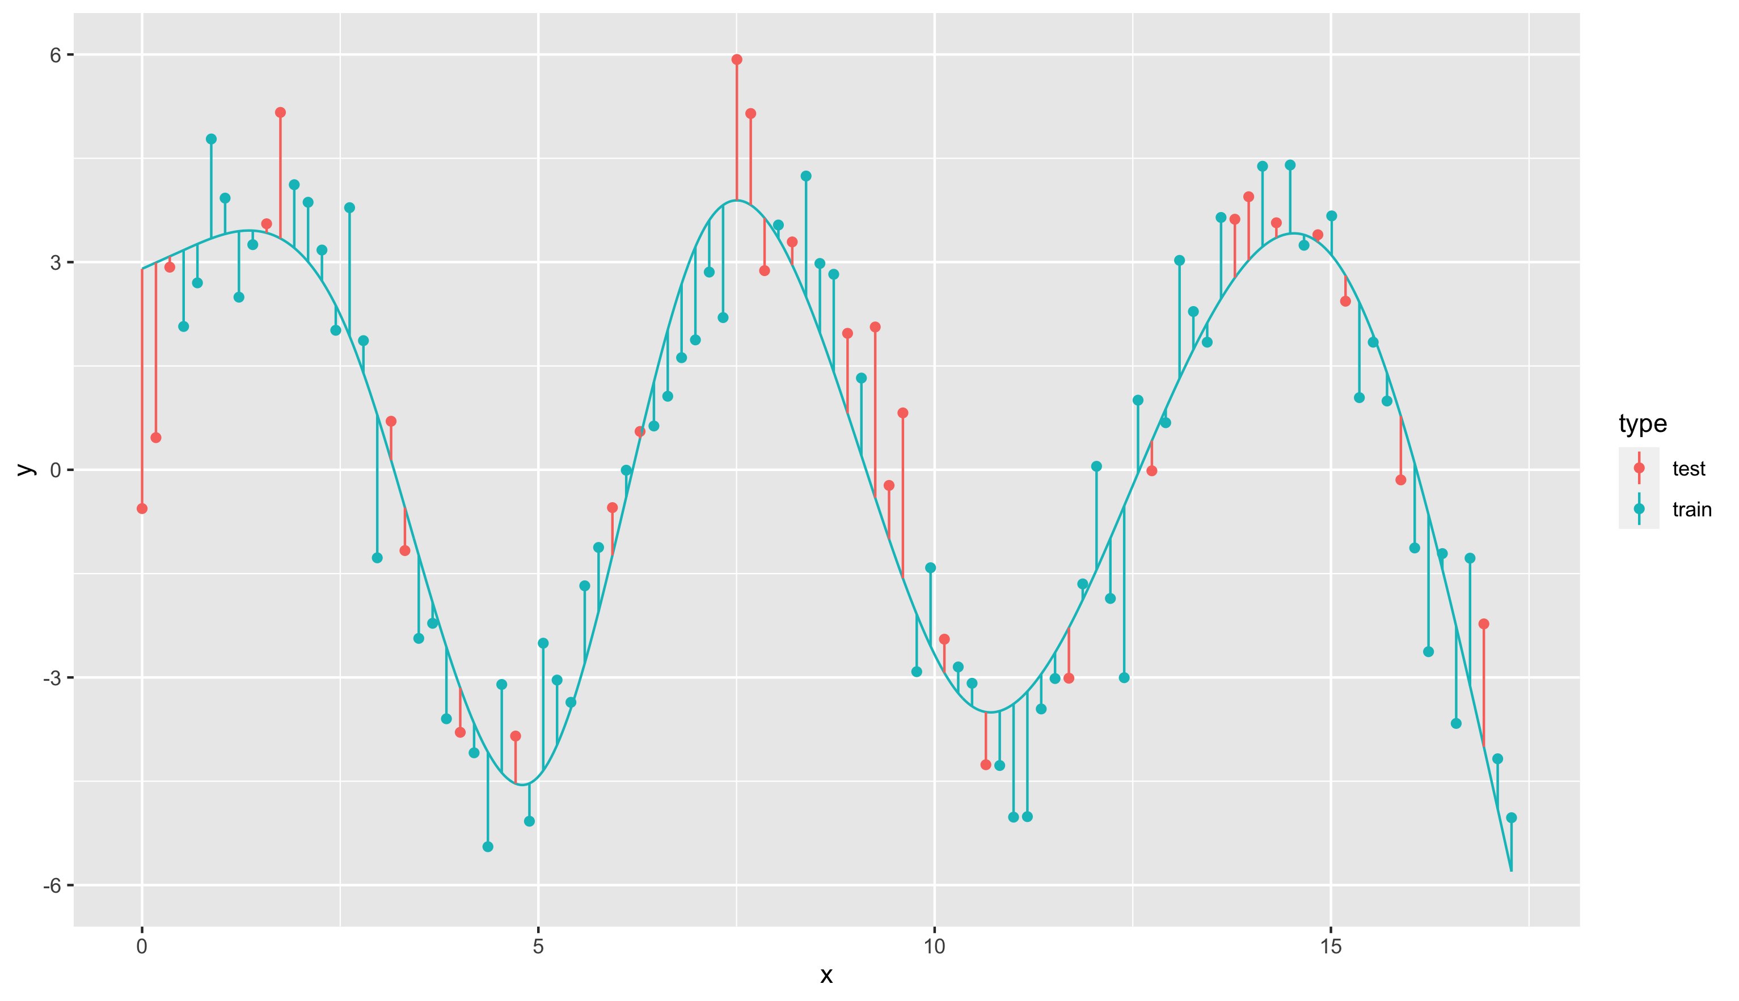
Modeling more complex patterns
Natural spline with 5 degrees of freedom
Natural spline with 7 degrees of freedom
RMSE_train = 1.988
RMSE_test = 3.120
RMSE_train = 1.092
RMSE_test = 1.310

Slide 23
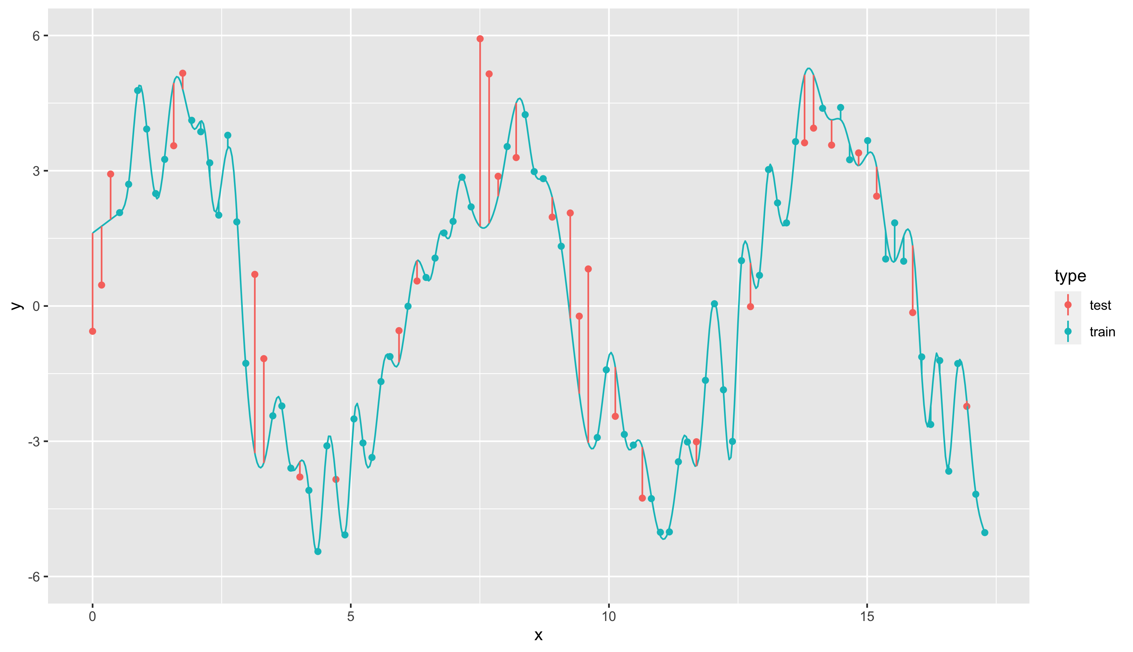
Modeling more complex patterns
Natural spline with 65 degrees of freedom
RMSE_train = 0.189
RMSE_test = 1.783
Error on training is low, but error on test set is much higher Model does not generalize well.

Slide 24
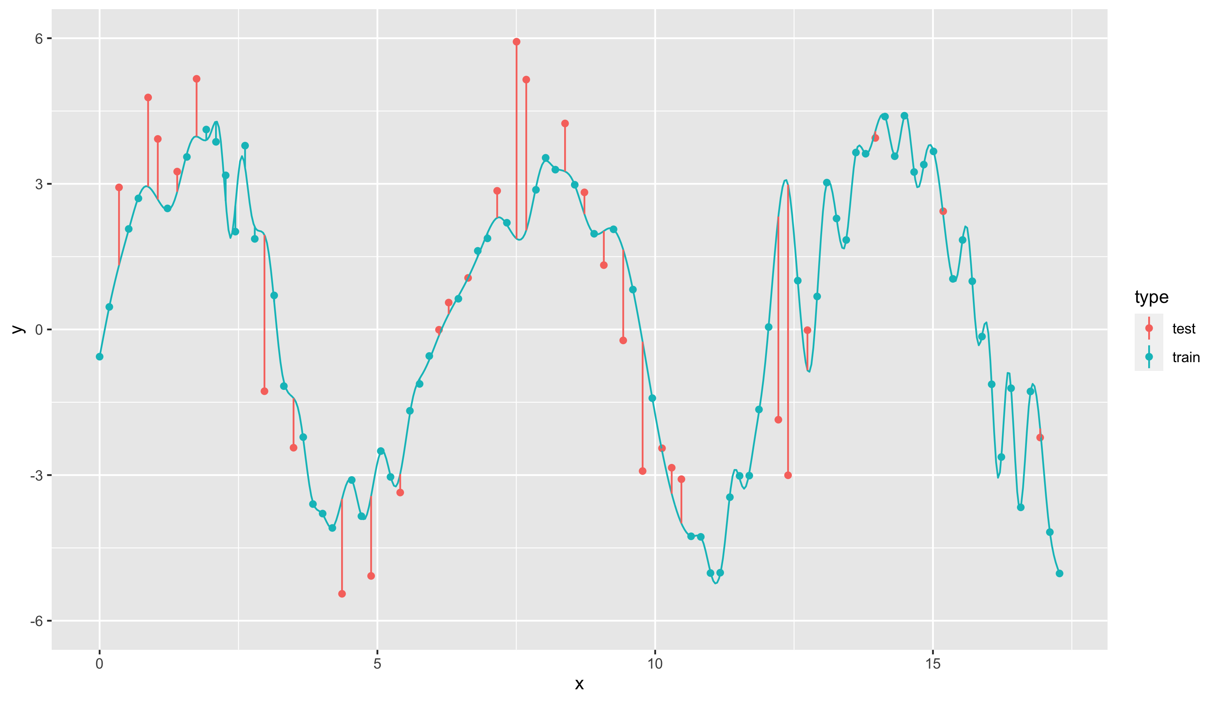
Sensitivity to train/test split
Natural spline with 65 degrees of freedom,
train/test split v1
Natural spline with 65 degrees of freedom train/test split v2
Also called variance: error from sensitivity to small fluctuations in the training set

Slide 25
Under- and overfitting
Natural spline with 3 degrees of freedom
Natural spline with 65 degrees of freedom
Underfitting
Model is not complex enough
Overfitting
Model is too complex
Model is too sensitive to the training data Model does not generalize well

Slide 26
The bias-variance tradeoff
High bias
Low variance
Low bias
High variance
Notes:
High bias: model is bad for the data
Low variance: Another train/test-split would have given roughly the same model
Low bias: Model is really well fitted to the data
High variance: Another train/test-split would have given a very different model

Slide 27
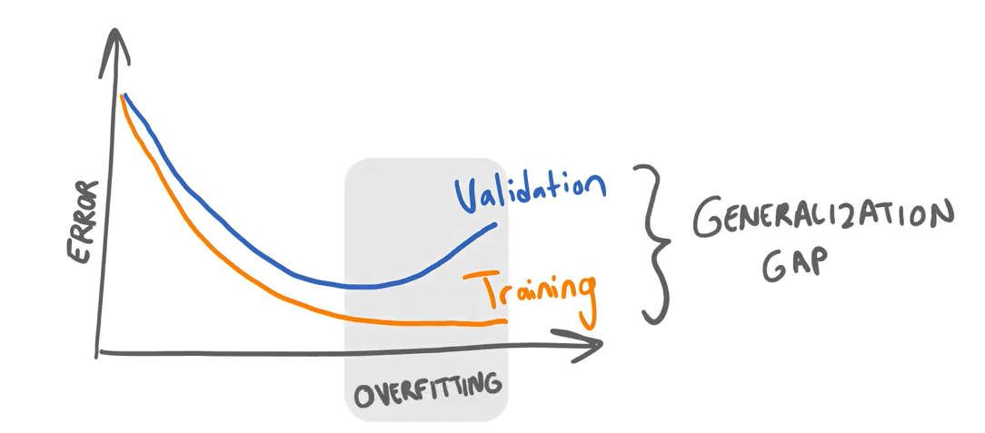
How to find the sweet spot?
Not allowed to use the test set!
Split up dataset in 3 parts
Build model on training set (60%)
Check complexity against validation set (20%)
Verify quality on test set (20%)

Slide 28
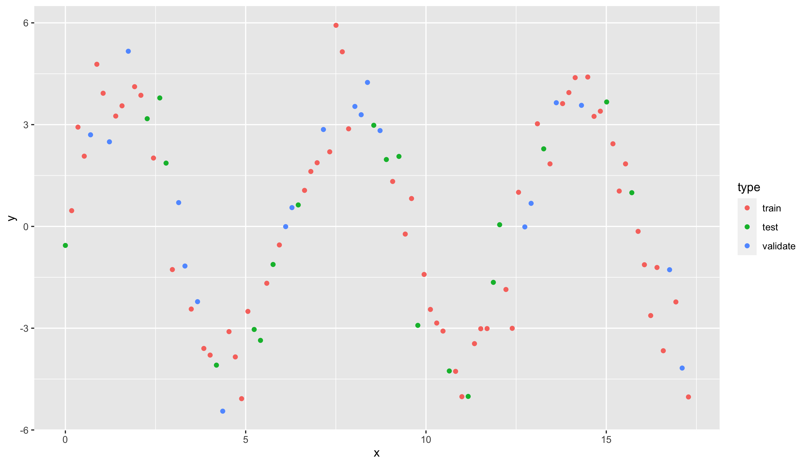
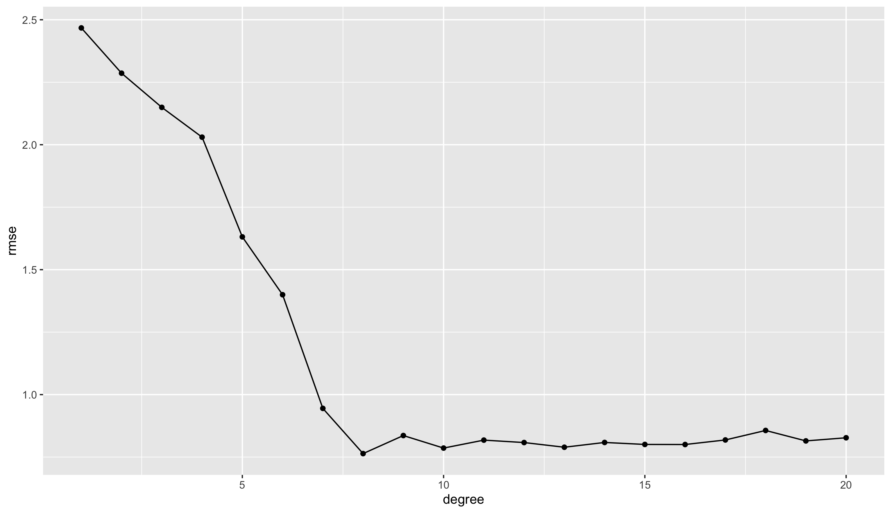
Divide data in three subsets Track RMSE as complexity increases
Low bias High variance
Sweet spot OK bias OK variance
High bias Low variance
No improvement

Slide 29
There’s a great example of this in code at: https://towardsdatascience.com/understanding-the-bias-variance-tradeoff-and-visualizing-it-with-example-and-python-code-7af2681a10a7
Notes:
https://towardsdatascience.com/understanding-the-bias-variance-tradeoff-and-visualizing-it-with-example-and-python-code-7af2681a10a7

Slide 30
Problems in data
The data you get will have issues
Not made available
Wrong format
Datetimes (not a real problem, but annoying)
Contains outliers
Ordinal and nominal (important to figure out)
Contains missing values
Has bias
Notes:
Not made available: a student last year’s internship was “scrape all the price data for holiday parks, so our client can use this data to better position themselves in the market.” Very nice dataset by the way.
Wrong format: Feature engineering
Datetimes: https://datagy.io/pandas-datetime/

Slide 31
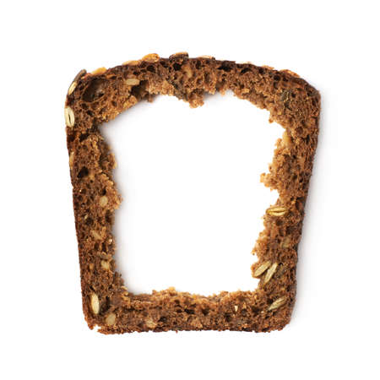
No slide (or slice)
Read 2.1 - outliers.md
Read 2.2 – ordinal and nominal.md
Read 2.3 – missing values.md
Also read 2.3 - missing values.ipynb in “scripts”
Read 2.4 – bias.md
Read 2.5 - normalization.md

Slide 32
Tools
A lot of tools are needed at this point. You’ve come across some of them last year in the datascience course in 2ITF, but make sure you’re still comfortable with all of them.
Python running in Jupyter notebooks on SageMaker
And as libraries:
Pandas
Matplotlib
Numpy
Seaborn
Scikit-learn
…

Slide 33
More exercises!
You already did the diamonds modeling exercise
Next up are:
3.1 - Wine quality.ipynb
3.2 - Car evaluation.ipynb
3.3 - Vertrebral column.ipynb
2.2 - Titanic.md
Yes, these are exercises from the next module, but the topics they cover fit perfectly in this chapter.
You’re ready.
I believe in you.

